Slide 1
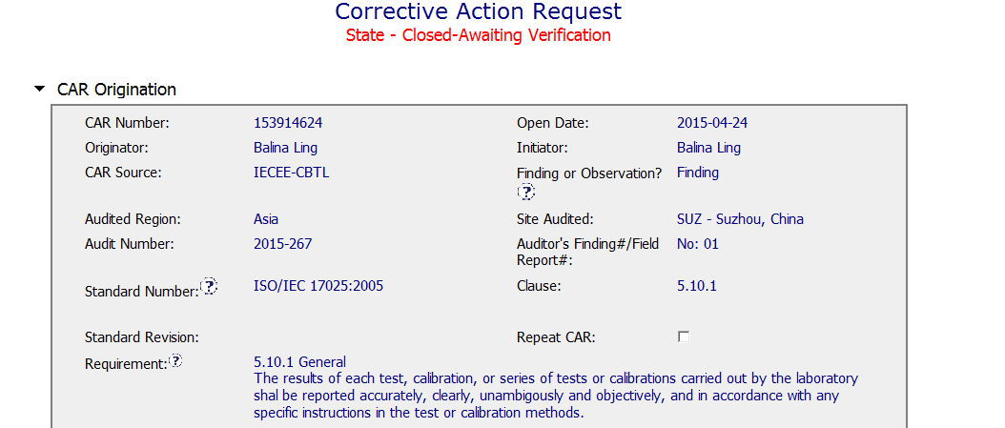
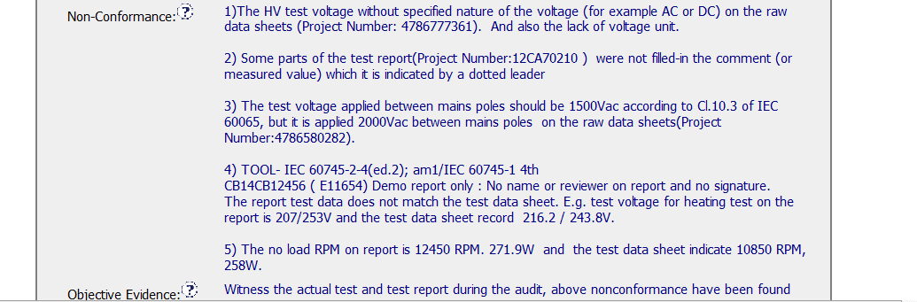
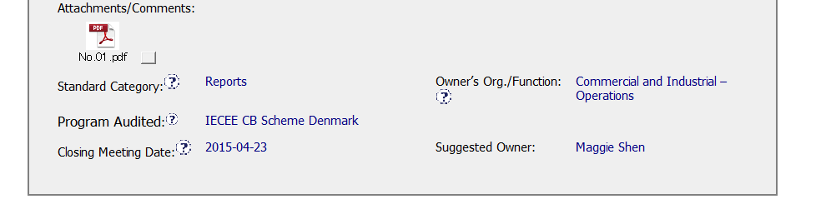
CAR 153914624
Attaching the actual Non-Conformity Report written by the auditor helps

Slide 2
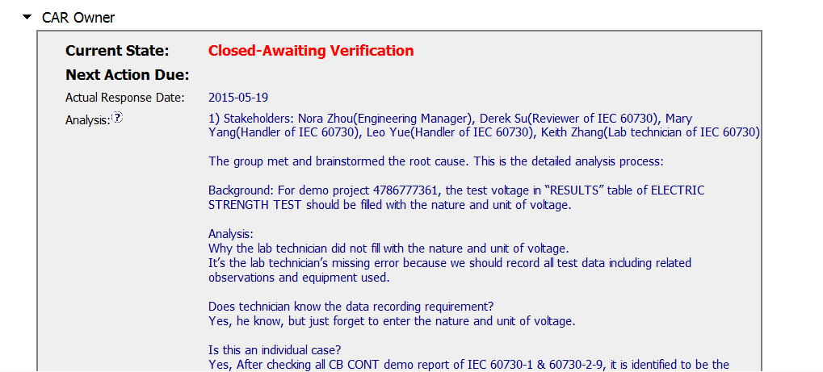
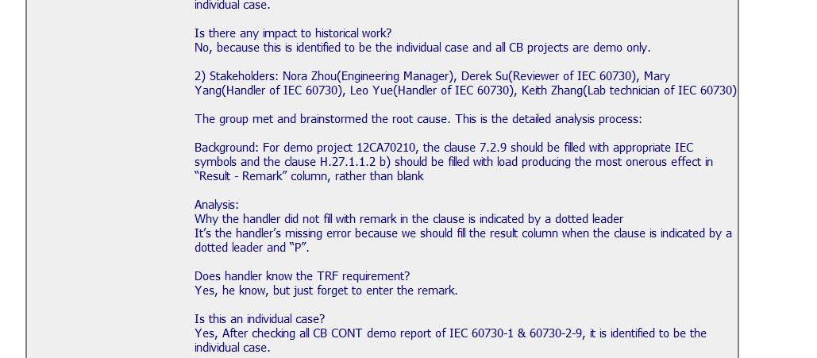
CAR 153914624
Stakeholders were identified for each item
Analysis done for each non-conforming item individually
Background information provided for each item helps understand the issue
Analysis includes whether the items were isolated incidents and indicates what was checked
Also includes an analysis of whether there is any impact on completed projects

Slide 3
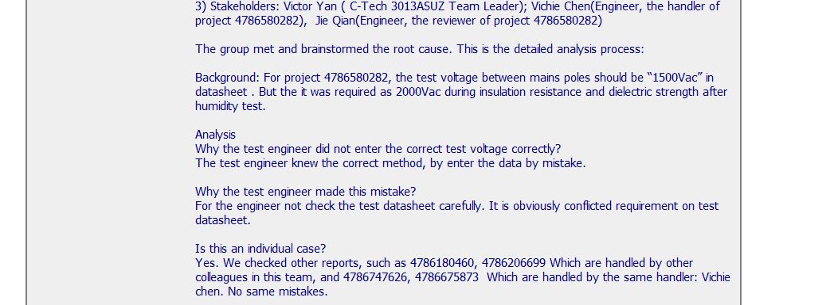
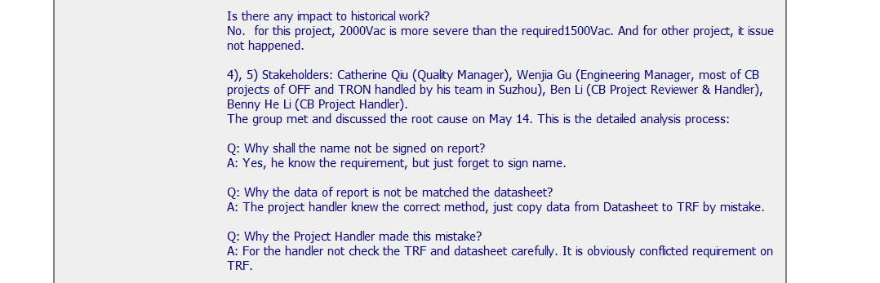
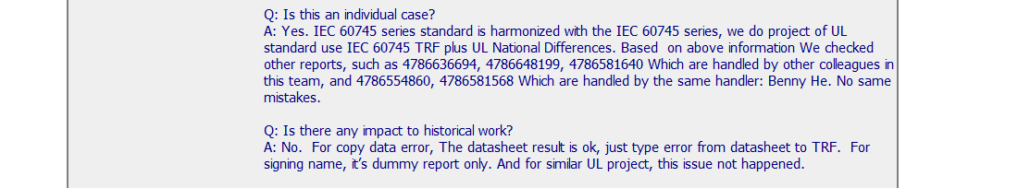
CAR 153914624
Five Whys Method used for this item

Slide 4
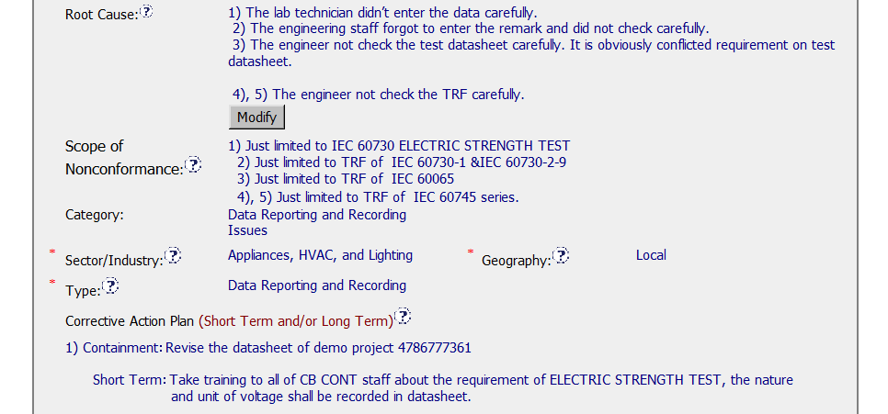
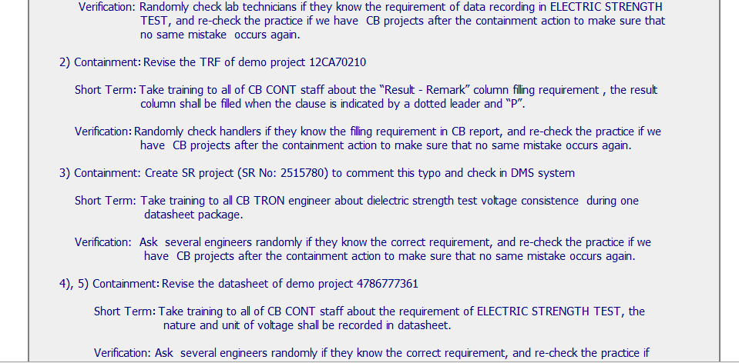
CAR 153914624
Root cause was determined to be lack of care based on all the items being isolated incidents
Scope is based on the analysis
Containment, short term corrective action and verification developed for each item

Slide 5
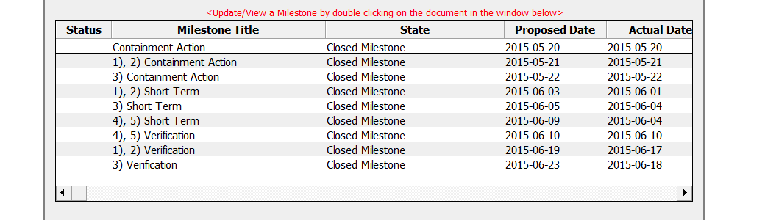
CAR 153914624
Milestones were established for each item. They all met the proposed due date.

Slide 6
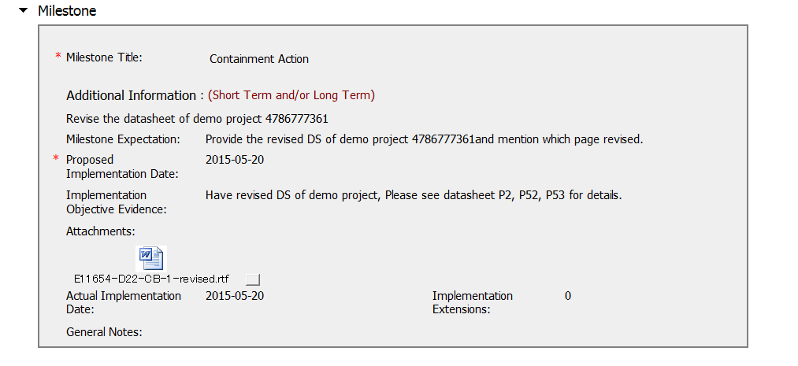
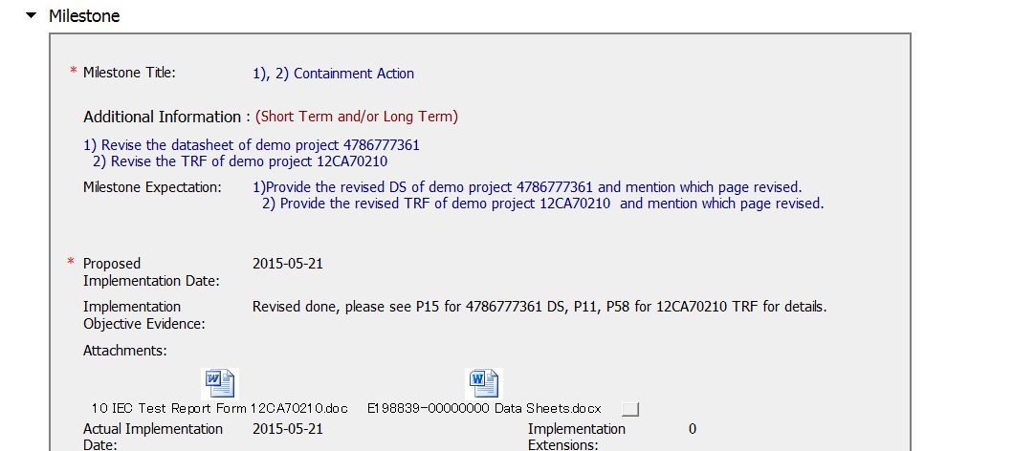
CAR 153914624
Implementation evidence attached to the milestones together with an explanation of what was changed
Implementation evidence attached to the milestones together with an explanation of what was changed

Slide 7
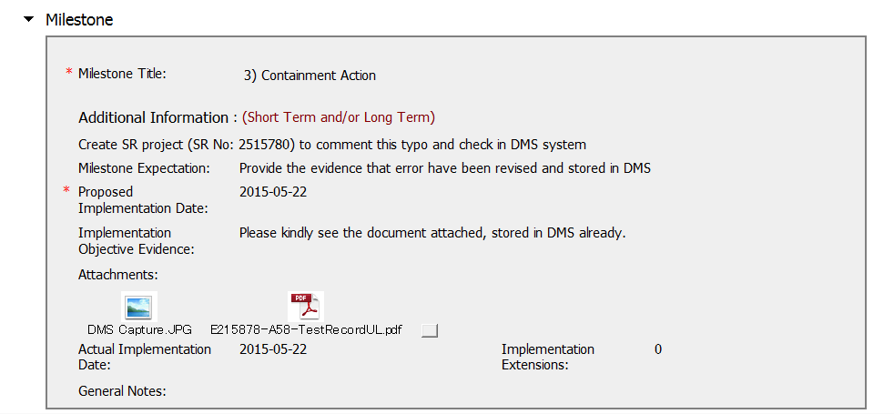
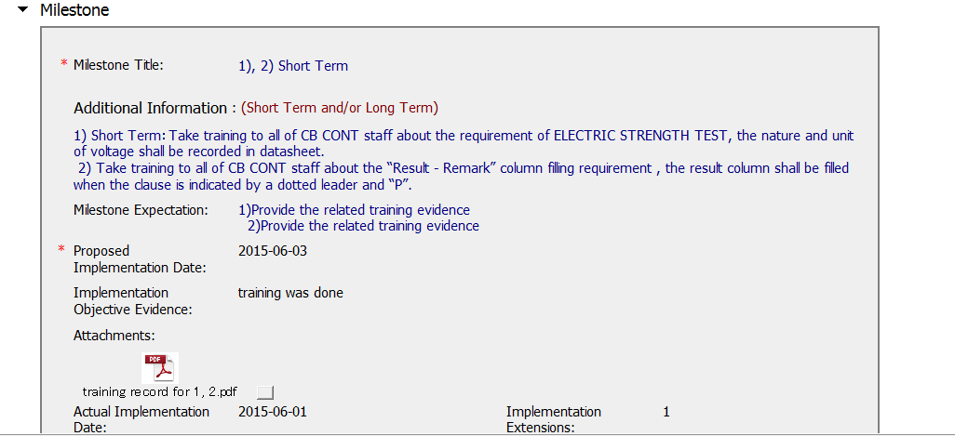
CAR 153914624
Evidence of DMS entry
Training record includes trainer and trainee names, employee nos., signatures, dates and times, and training content

Slide 8
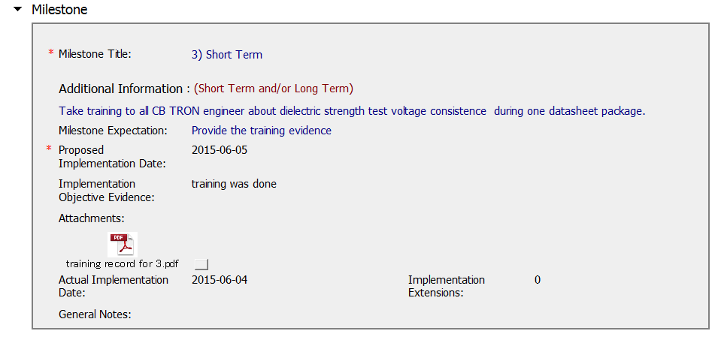
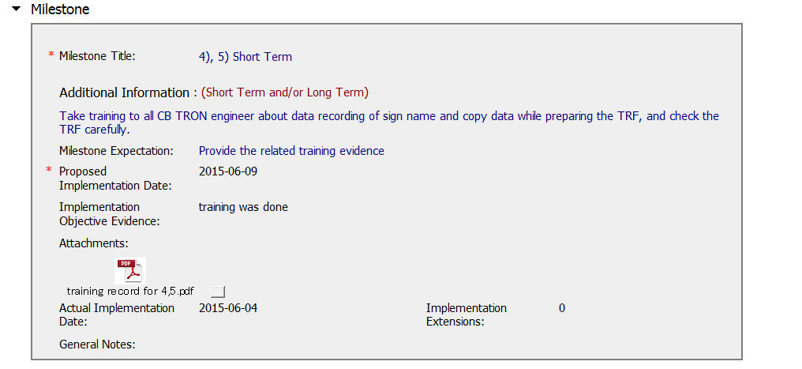
CAR 153914624
Training record includes trainer and trainee names, employee nos., signatures, dates and times, and training content
Training record includes trainer and trainee names, employee nos., signatures, dates and times, and training content

Slide 9
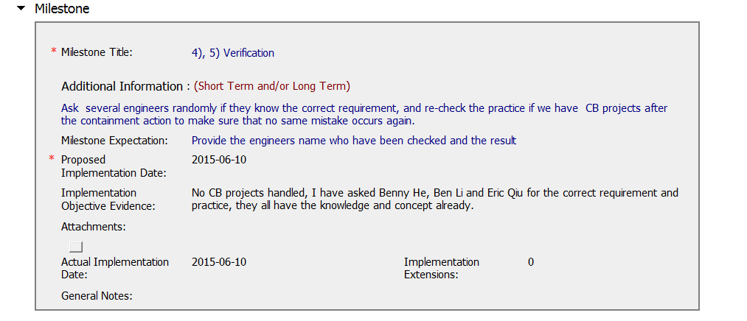
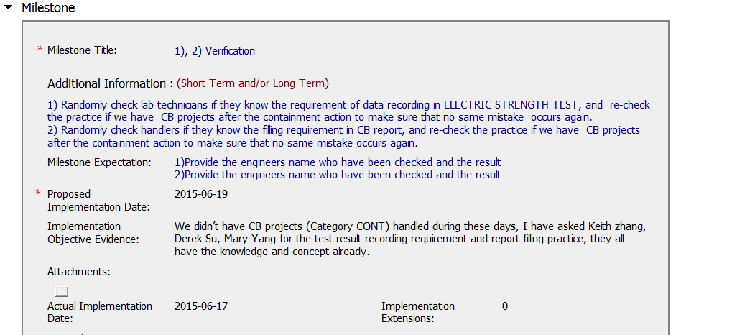
CAR 153914624
The 3 verification milestones indicate that the individuals were asked if they knew the requirement, because there were no new projects.
Perhaps a statement could have been added to indicate no future prospect project.

Slide 10
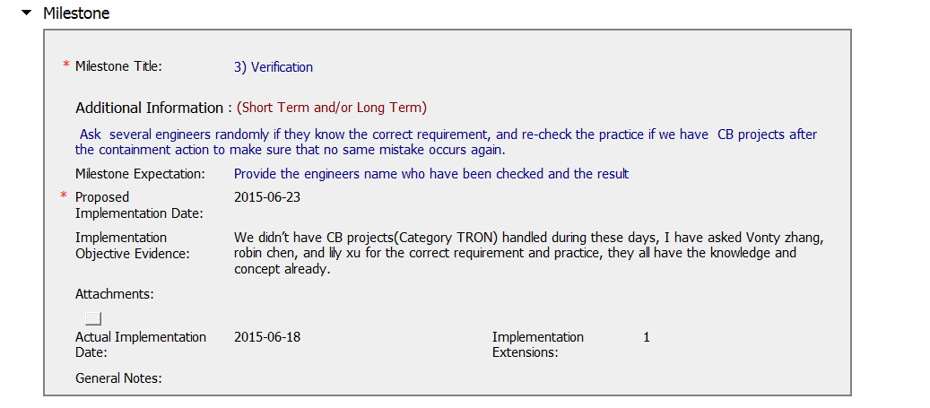
CAR 153914624

Slide 11
CAR 153914404 – CBS Check
CBS Requirements | Excellent | Moderate | Need Improve | N/A
(C) Extensions are within requirement (<30 days, 3 or less) | √
(T) Most appropriate ‘category’, ‘type’, ‘geography’ are selected | √
(P) Facilitates the handling of disputed CARs |  |  |  | √
(T) Acts on CARs within required timeframe | √
(C) Analysis shows clear path to root cause and scope; stakeholders identified | √
(C) Root cause statement is succinct, reasonable, complete (Shows ‘N/A’ for observations) | √
(C) Corrective actions fix the objective evidence and other problems found; address entire root cause and scope. For observations, they do not go beyond fixing the objective evidence | √
(C) Milestones address containment & owner’s verification; completed per milestone expectations | √
(P) Verification per requirements | √
(L) Referenced communications are attached as needed | √
(C L) Evidence of communication for overdue/escalated CARs and other pertinent concerns |  |  |  | √
(P) Trains other CAR Champions |  |  |  | √

